Slide 1
Kennecott Utah Copper

Slide 2
Where we started
Idle Reduction Program
Where we are now
Vehicle Reduction Project
Where do we go from here
Fleet Utilization Program

Slide 3
Where we started
2008 – Current
Idle Reduction Program
The first step in the development of our idle reduction program was to determine the outcomes we were looking for. Determine what we wanted to get out of an idling program.
Reduce emissions
Reduce / manage engine non-productive operating hrs
Increase vehicle availability
Notes:
The first step in the development of our idle reduction program is to determine the outcomes you’re looking for. Determine what you want to get out of an idling program.
Reduce emissions
Reduce manage engine non-productive operating hrs
Increase vehicle availability
We came up with this vision statement:
Develop a Idling reduction program that controls idling of vehicles, reduces GHG emissions and increases vehicle availability while ensuring the program is sustainable for years to come.

Slide 4
Idling program vision statement
Develop an idling reduction program that controls idling of vehicles, reduces GHG emissions and increases vehicle availability while ensuring the program is sustainable for years to come.

Slide 5
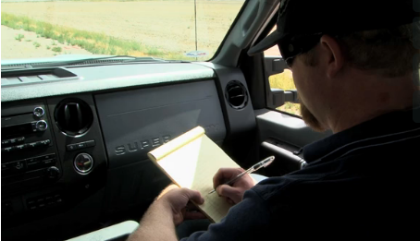
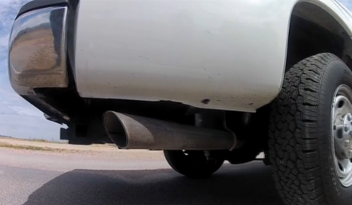
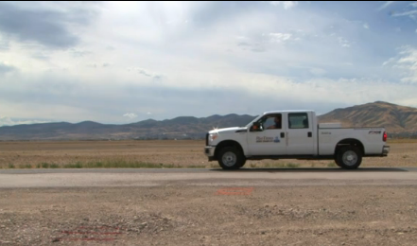
Change culture, behavior & procedures
Insert new photo
Small changes can make a big difference
Notes:
A simple telling people not to idle does not do anything for an idling program
An idle reduction program requires a cultural change within your workplace. Management, vehicle operators and all others involved should be included in the training to help everyone understand the reasons (both financial and environmental) that idle reduction is beneficial.
Changing operator behavior around small and medium duty vehicles’ idling
Changing operator’s behavior and operating procedures on heavy mobile loaders and haulers bring about huge gains
Learning to:
Shut down equipment when not in use
Auto shut off on large mobile equipment where needed

Slide 6
Education of operators
Through years and years of Engineering Experience from Ford, Caterpillar and John Deere; to name a few, baselines were generated for fuel consumed and equivalent miles traveled per idle hour.
Light Duty Vehicles 1996-2009 (Gasoline)
1 Idle hour = 2 gals. of fuel and 26 miles traveled.
Light Duty Vehicles 2010-2016 (Gasoline)
1 Idle hour = 1 gal. of fuel and 26 miles traveled.
Light to Medium Duty (Diesel)
1 Idle hour = 2-3 gals. of fuel and 26 miles traveled.
Heavy Duty Mobile (Diesel)
1 Idle hour = 3.5-4.5 gals. of fuel
Heavy Haulage Trucks (Diesel)
1 Idle hour = 6.5-7.5 gals. of fuel
Lessons learned:
Educate on the findings: example show idling lowers MPG by 45-50%, gallons wasted, savings
Example of facts shared with operators:
Engine wear is greater at prolonged idle than during normal operation
Modern cars need little warm up time
Every gallon of gas burned produces 20 pounds of carbon monoxide
Manufactures for certain vehicles and equipment warranties are not only based on miles they are also based on hours.
Notes:
Collect data and use facts
Don’t pick out operators – pick out vehicles
Educate on the findings: example show increased MPG, gallons wasted, savings
Show data pertaining to audience
Compliance vs. Big Brother can make a big difference
Example of facts shared with operators:
Engine wear is greater at prolonged idle than during normal operation
Modern cars need little warm up time
Every gallon of gas burned produces 20 pounds of carbon monoxide
Manufacturers measure the amount of idling when doing warranty work
Measurement:
Data needs to be collected – no way to measure the program – That is why we are using Telematics.
No way of reporting results if there was any idling
The best program in the world will not work without back up data

Slide 7
Reports
All managers get idling, speed and GHG reports weekly and monthly
Supervisors of fleet get daily, weekly and monthly reports
A monthly and quarterly report on idling and savings go to all levels of KUC
Several plants get special reports designed to be used on their information boards

Slide 8
2016 YTD Cumulative Idle 4.6%

Slide 9
Idle reduction program current results
2016 YTD Cumulative Totals
Dollar Savings |  | $ 1,023,572.08
Gallons Reduced |  | 466,959.59
GHG Tons Reduced |  | 4,741.43
Engine Run Time Hrs |  | 133,114.95
Engine Idle Time Hrs |  | 6,148.05
Project Cumulative Totals 2008 - 2016
Fuel Dollar Savings |  | $16,862,836.71
Gallons Reduced |  | 5,498,790.59
GHG Tons Reduced |  | 55,995.77

Slide 10
Where we are now
2015 - 2016
Vehicle Reduction Project
We started an aggressive project with the purpose to reduce 50% of our fleet.
Fleet Reduction Target: 50% = 250 vehicles
Criteria for removal of vehicles:
Age
Condition
Cost
Usage

Slide 11
Problems Solutions
Not enough vehicles to get people around or “I need my own vehicle”
Certain tasks now require more trips to shuttle people around
Some teams have many vehicles while some teams do not have enough
Change mindset from people having their own vehicle to car pooling with others.
Removed a lot of low passenger vehicles (single cab trucks) and incorporated more vans and buses
Created a fleet pool system at multiple sites where anyone can check out a pool vehicle

Slide 12
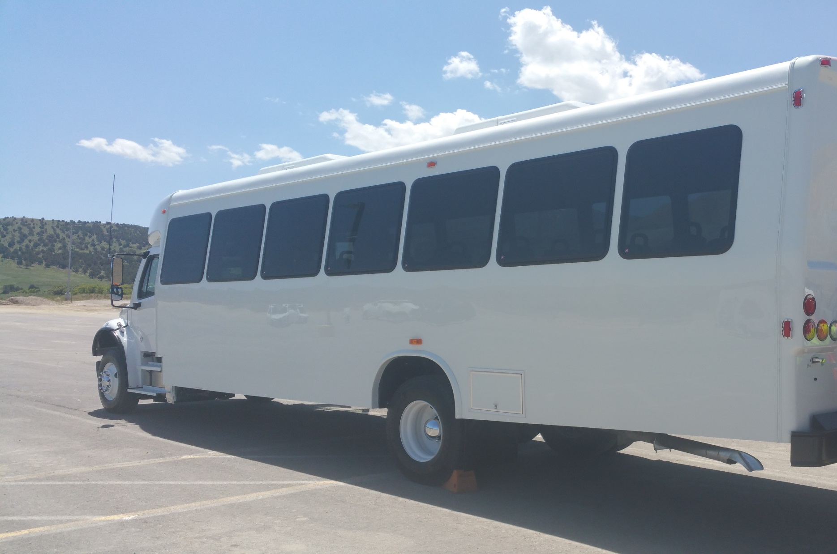
Fleet reduction results
255 total pieces of equipment reduced
Amount of vehicle trips and drive time significantly reduced
Cost savings:
Reduced maintenance costs from older equipment
Lower cost for annual fleet registration
Revenue from selling vehicles
Lowered emissions from usage of buses and vans

Slide 13
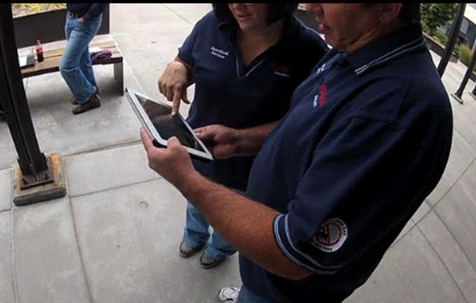
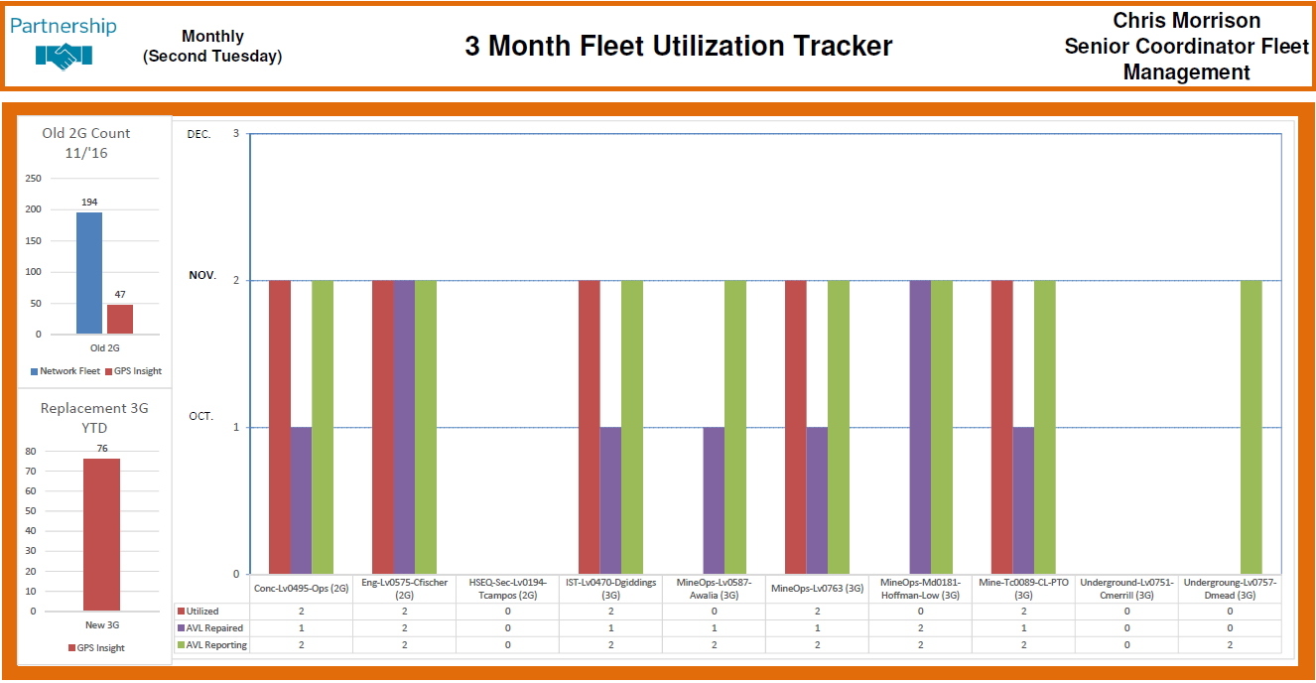
Where do we go from here
2017
Fleet Utilization Program
Goals:
Optimize the usage of each vehicle
Re-allocate or reduce vehicles that have low usage
Measurement:
Any vehicle that is driven less than 5 days and/or 100 miles in a month is put on a evaluation list to be watched for 3 months
Then we decide if the vehicle will be for re-allocation or removed from service

Slide 14
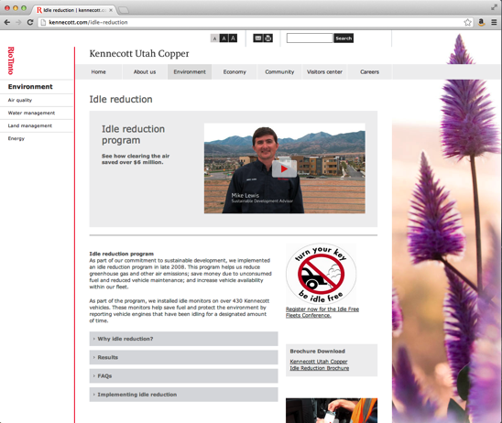
kennecott.com/idle-reduction
Notes:
In closing. we invite you to take a closer look at our idle reduction program by checking out our online idle reduction toolkit. The toolkit contains:
Videos about our idle reduction program
Frequently asked questions
A downloadable brochure about implementing an idle reduction program
Links to additional resources like Utah Clean Cities, as well as Salt Lake City and the U of U Office of Sustainability idle reduction programs

Slide 15
Kennecott Utah Copper

